Slide 1
Stock Market Volatility Analysis
Submitted By:
Sofiqul Islam Sohan
ID: 2114951042
Section: 7C_Special
Submitted To:
Saima Siddique Tashfia
Lecturer, Dept of Computer Science and Engineering, UITS
Submission Date: 01/06/2025

Slide 2
Introduction
Stock Markets are Inherently Volatile And Unpredictable
Understanding and modeling volatility is crucial for risk assessment, portfolio management, and forecasting.
Dataset focuses on Apple share from January-May 2025

Slide 3
Objective
Simulate Stock Price Behavior
Evaluate Statistical Properties of the Simulated Data
Validate and Compare Simulated Result Against Real Data

Slide 4
Methodology
Data Gathering
Monte Carlo Simulation
Statistical Testing
Visualization and Interpretation

Slide 5
Monte Carlo Simulation
Generates multiple random future price paths
Geometric Brownian Motion is Used
Formula Used St​=S0​⋅e(μ−21​σ2)t+σWt​

Slide 6
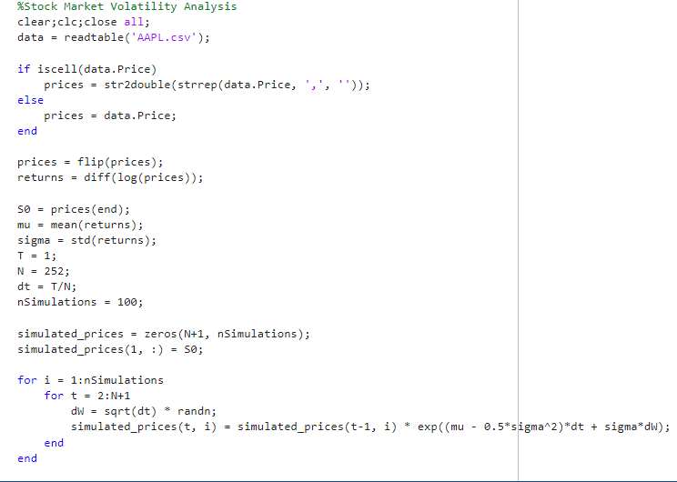
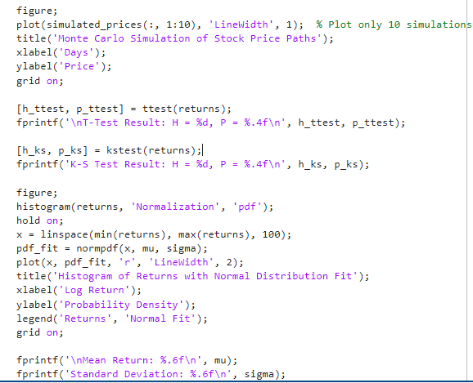
Matlab Implementation

Slide 7
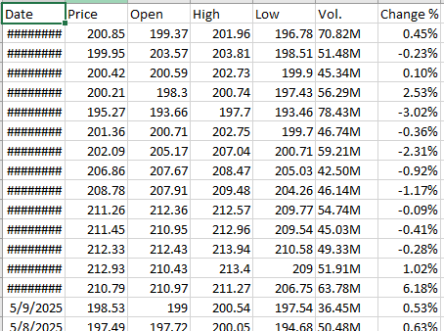
Dataset

Slide 8
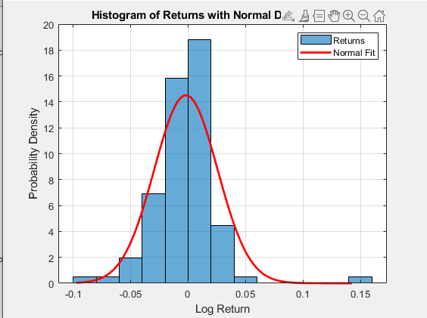
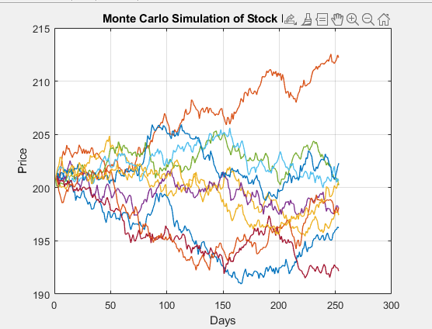
Graph Visualization

Slide 9
Key Takeaway
Monte Carlo models price behavior under uncertainty.
T-Test & K–S Test validate similarity to real data.
Simulation reveals key volatility insights.

Slide 10
Reference
Hull, J. C. – Options, Futures, and Other Derivatives
Glasserman, P. – Monte Carlo Methods in Financial Engineering
MathWorks (MATLAB) Documentation – ttest, kstest, randn, plot, etc.
Investing.com – Historical stock price data (CSV export)
ChatGPT (OpenAI, 2025) – Assisted with project outline, explanations, and presentation structuring
GitHub - https://github.com/SofiqulSohan/StockVolatilityAnalysis/

Slide 11
Thank You
Any Questions?

